Slide 1
第四章 组合体
Chapter 4 Composite Solids

Slide 2
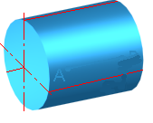
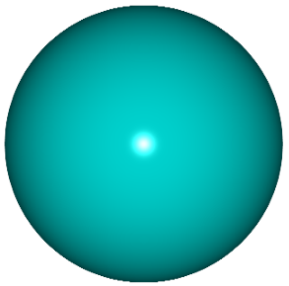

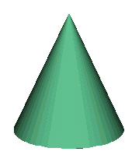
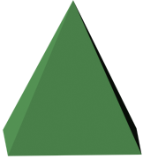
常见的基本几何体
Most widely used Basic Solids
平面基本体
Plane Basic Solids
曲面基本体
Surface Basic Solids
圆球 Sphere
圆柱 Cylinder
圆锥 Cone
棱柱 Prism
棱锥 Pyramid

Slide 3
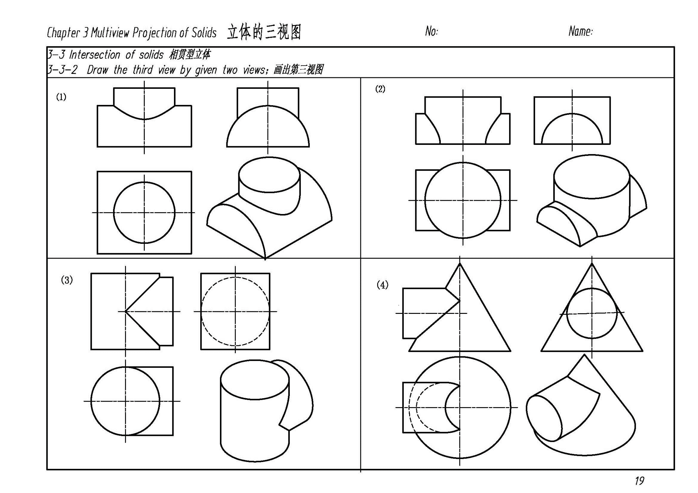

Slide 4
组合体 —— 由平面体和/或曲面体组成的物体
A complex can be combination of several planar solids and/or curved surface solids
组合体的组成方式How a complex constructured：
(1) 叠加 Superposition
叠加的形式包括Superposing can be：
表面不平齐叠加
Non-coplanar
表面平齐叠加
Coplanar

Slide 5
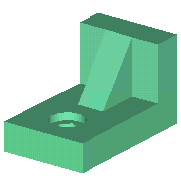
同轴叠加
Coaxial
非对称叠加
Non-symmetrical
对称叠加
Symmetrical

Slide 6
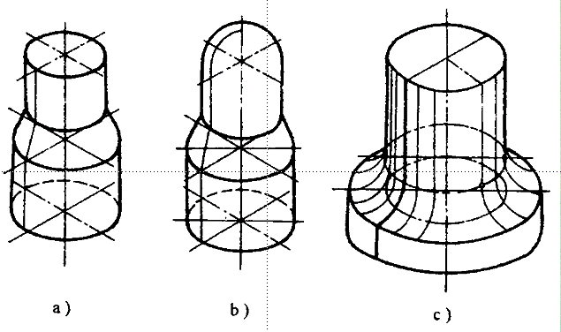
同轴旋转
Coaxial revolving

Slide 7
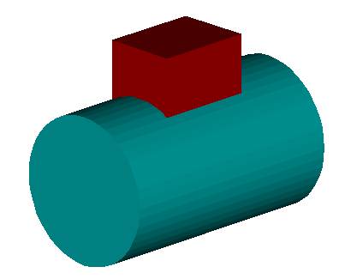
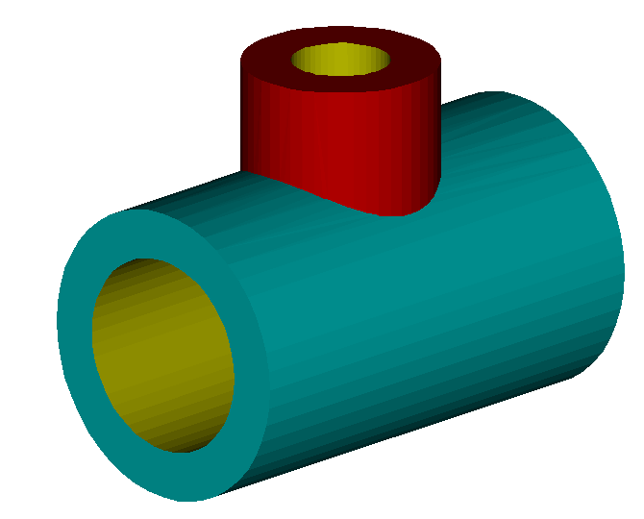
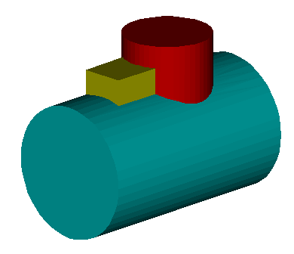
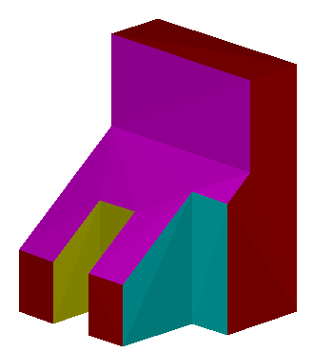
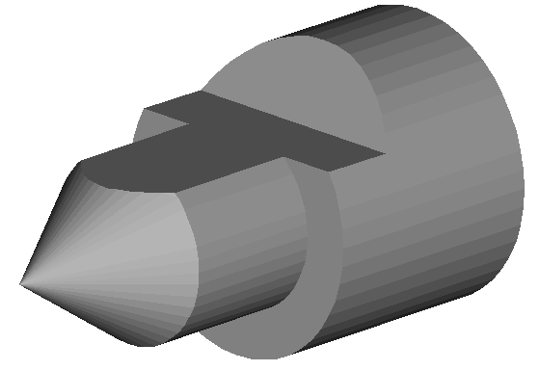
(2) 相交 Penetration
(3) 截切 Truncation

Slide 8

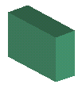

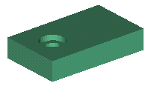
例1：画出所给叠加体的三视图。 Complete the three views of object
立板
Side board
肋板
Rib
分解形体Breaking up
叠加方式(Relative positions)
• 底板和立板右面平齐叠加
Side board is added to base by both right faces being co-planar
• 肋板与底板和立板对称叠加
Rib is added to base and side board symmetricaly
底板
Base

Slide 9
叠加体的三视图 Three views of piled-like solid
I. 叠加体的投影分析 Analysis of projections
形体分析法：
根据叠加体的形状，将其分解成若干部分，弄清各部分的形状和它们的相对位置及组合形式，分别画出各部分的投影。
By analysis of the form and structure of the object, breaking up the object into several parts which are or close to basic solids and making out their relative positions. Draw their projections respectively .

Slide 10
• 分块画图
Complete three views of one part ,then another one.
看得见的线画实线
Visible lines with solid linetype
看不见的线画虚线
Invisible lines with dashed linetype
①底板
Base
②立板
Side board
③肋板
Rib
表面平齐，应无线。
Co-planar ，no line

Slide 11
II. 已知两视图，求作第三视图。
Complete the third views by the given two views
分析投影，想象出物体的形状。
Analyze the given projections and imagine the object.
根据投影规律及“三等”关系，画出第三视图。
Complete the third view by the rule of “tri-equility”

Slide 12
III. 投影分析 Analysis of projections
1. 视图上图线的意义
The meaning of lines in views
平面
Plane
圆柱外形线
Contour elements of cylinder
① 一个平面的投影
A concentrating plane
② 面与面的交线(棱边)
Edge- intersection line of two planes
棱边
Edge
③ 回转体外形线
Contour element of a revolved solid

Slide 13
⒉ 利用线框，分析表面相对位置关系。
Determine the relative positions of faces by the closed polygon
视图中一个封闭线框一般情况下表示一个面的投影，线框套线框，则可能有一个面是凸出的、凹下的、倾斜的，或者是具有打通的孔。
A closed polygon usually means the projection of a plane. Two nested polygons possibly represent one plane protrudes , coved or inclined to the other one, or with through-hole.

Slide 14
两个线框相连，表示两个面高低不平或相交。
Two adjacent closed polygons means two planes intersect or with different height .

Slide 15
⒊ 要几个视图联系起来看，以确定物体的形状。
Determine the shape of the object by relating one view with the others
一个视图不能唯一确定物体的形状，往往需要两个或两个以上的视图才能唯一确定物体的形状。
One view cannot fix the shape of the object. Two or more views are usually needed to determine the object exclusively.

Slide 16
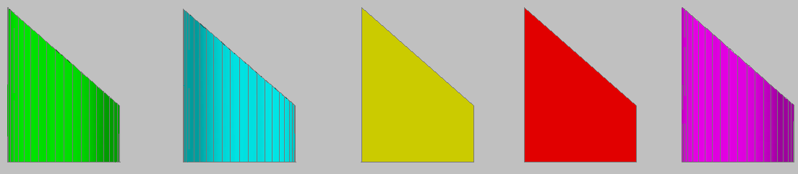
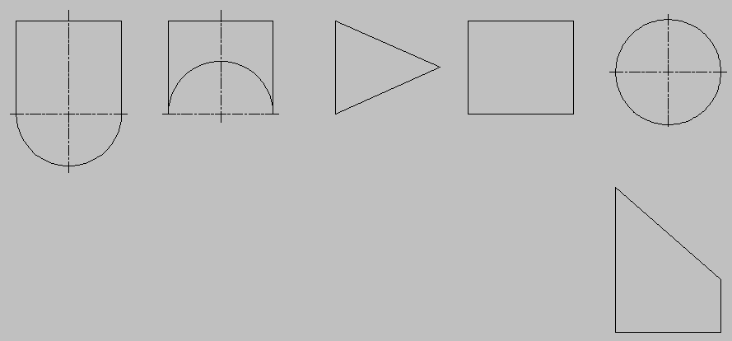
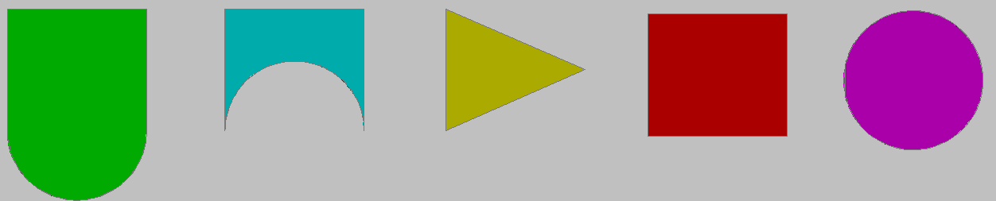
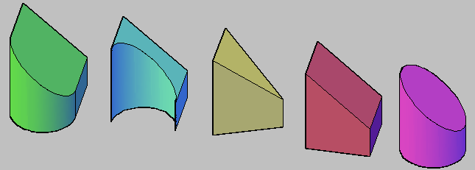
Notes:
一般的，为了进一步增强学生的专业知识，还结合学生专业，联系工程实际，引导学生进行构型练习。构型练习能引导学生的空间思维活动由单一向多元化发展，使学史在构型设计时，举一反三开拓思路，丰富头脑中关于形体可变因素的信息存储量。

Slide 17
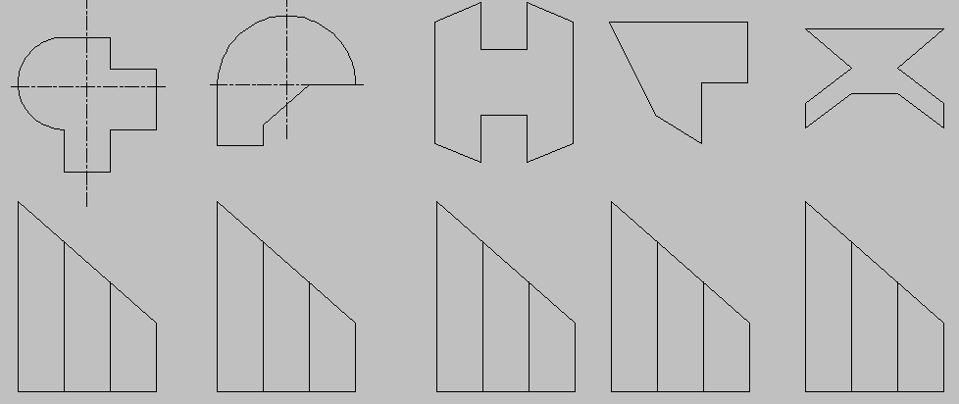
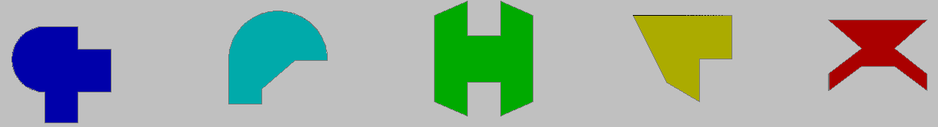
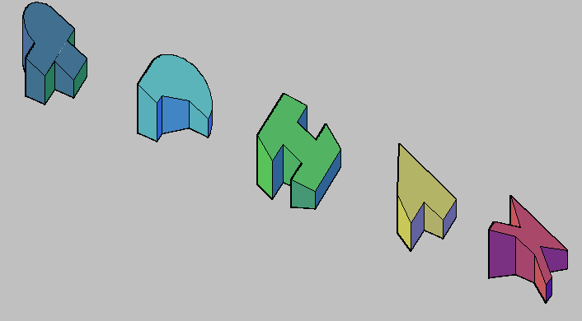
Notes:
组合体构形设计的目的, 主要是培养学生利用基本几何体构造组合体的能力及掌握组合体视图的画法。一方面提倡所设计的组合体尽可能体现工程产品或零部件的结构形状并满足其功能特点, 以培养观察、分析、综合能力; 另一方面又不强调必须工程化, 所设计的组合体也可以是凭自己想象, 以更利于开拓思路, 培养创造力和想象力。

Slide 18
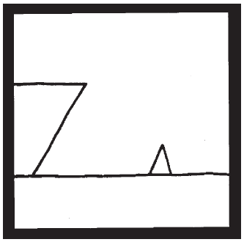
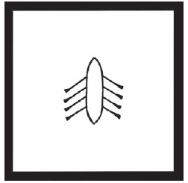
Ship Arriving Too Late to Save Drowning Witch.
This well-known drawing by artist
Roger Price is an example of how a single
orthographic view can be difficult to interpret.
George Washington Crossing the Delaware
as Seen by a Trout
单一投影图不能完整解释立体结构

Slide 19
⒋ 注意图中虚实线变化，区分不同形体。
Notice the difference between the dashed and continuous lines.
虽然三个视图基本相同，但由于主视图中虚实线各异，而得出两种不同的形体。 With almost same three views, only the different dashed and continuous lines in front views make two different objects.

Slide 20
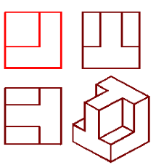
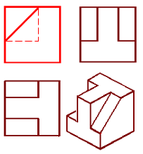
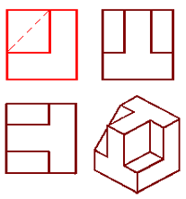

Slide 21
IV. 叠加形体之间的表面过渡关系
Transition between surfaces of different solids
⒈ 两形体叠加时的表面过渡关系 Transition of two superposed solids
无线
No line
虚线
Dashed line
实线
Solid line
平齐
Coplanar
(b)前面平齐
Coplanar in the front
(c) 不平齐
Non-coplanar
后面不平齐
Non-coplanar in the rear

Slide 22
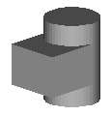
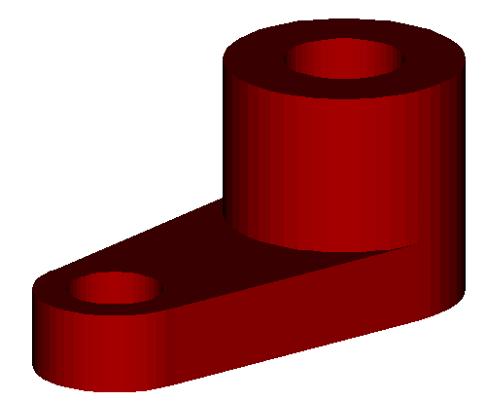
⒉ 两形体表面相切时，相切处无线。
No intersection line should be drawn when two surfaces are tangent.
无线
No line
无线
No line
无线
No line
●

Slide 23
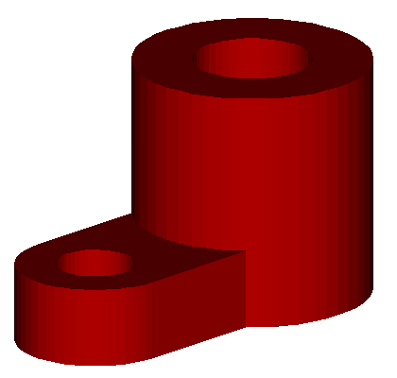
⒊ 两形体相交时，在相交处应画出交线。
The intersection line should be drawn when two surfaces are intersected (no tangent)
有线
Intersection line
有线
Intersection line

Slide 24
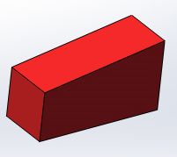
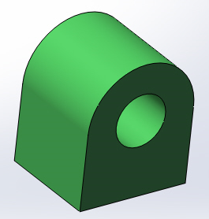
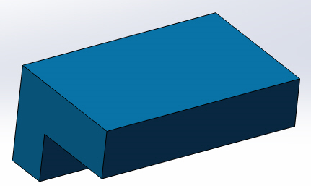
例：求做侧视图Complete the profile (left ) view
体3
Solid3
体2
Solid2
体1
Solid1
★分解形体，看懂形状Decompose the object and understand the structure

Slide 25
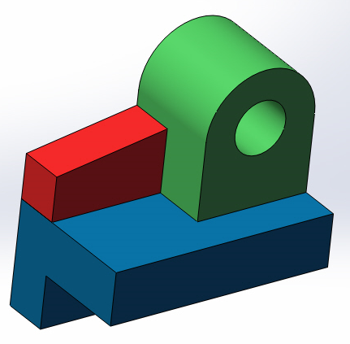
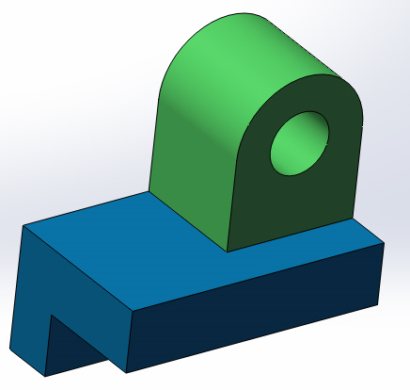
体2
体3
体1
★组合起来，想象整体形状

Slide 26
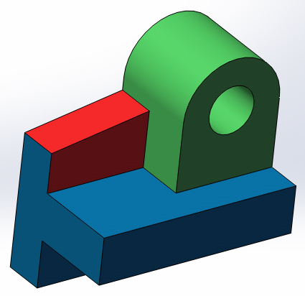
作图方法：
逐个画出各个形体，并分析体与体之间的表面过渡关系Draw each objects respectively and analyze the transition between surfaces
此处共面无交线

Slide 27
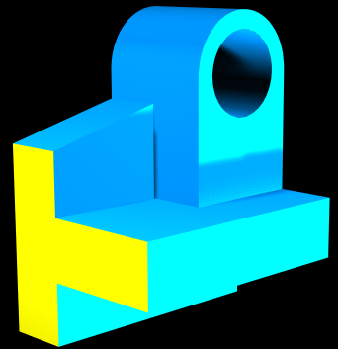

Slide 28
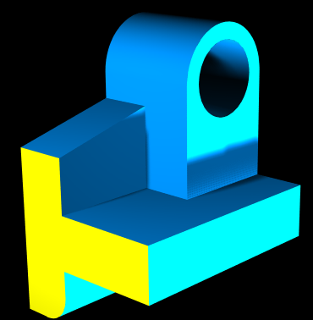
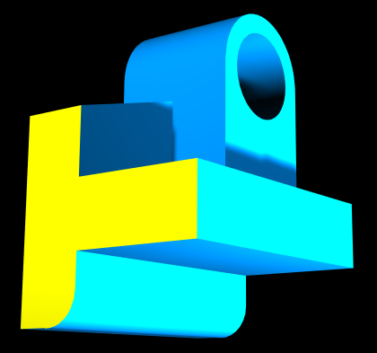

Slide 29
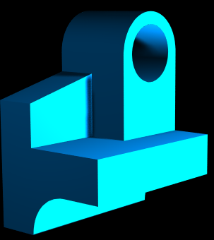
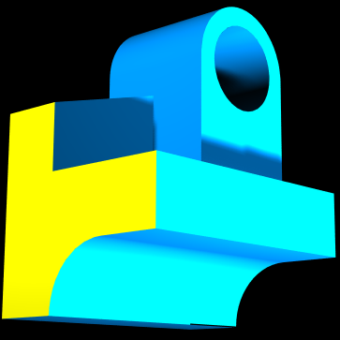

Slide 30
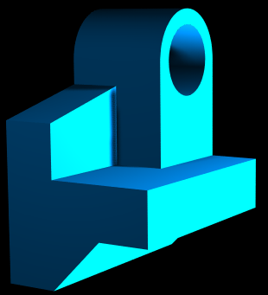
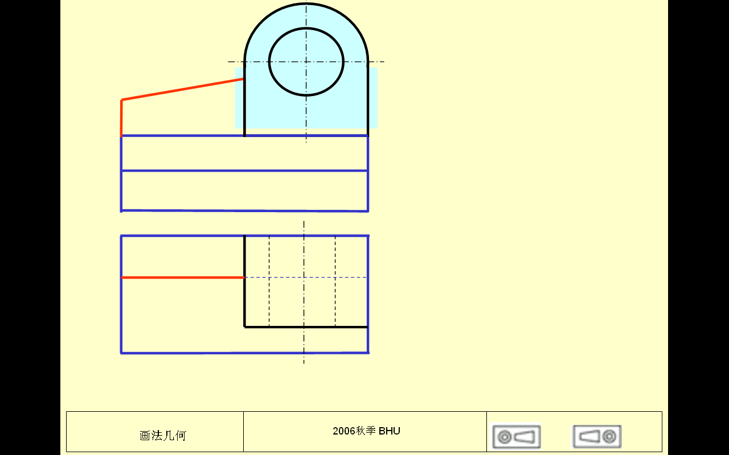
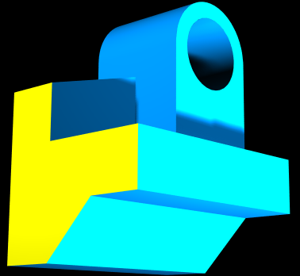

Slide 31
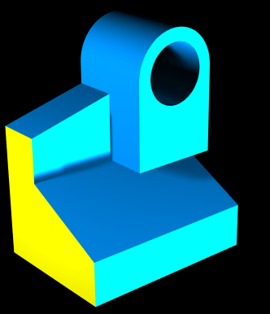
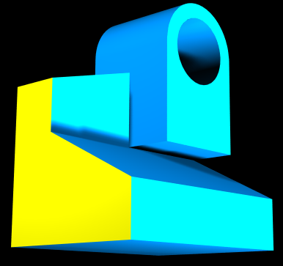

Slide 32
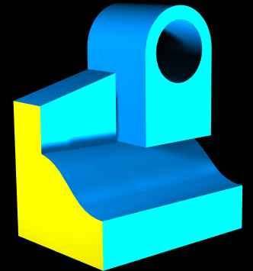
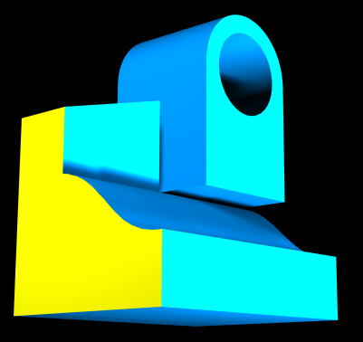

Slide 33
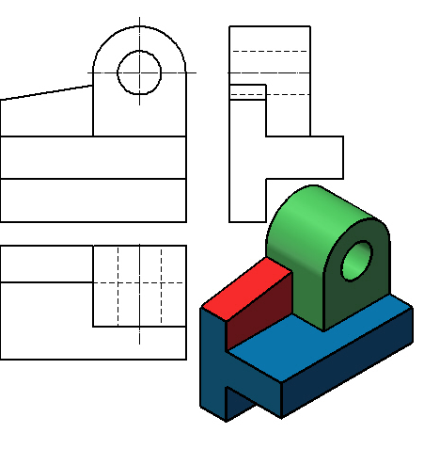
对于体2和体3，主视图是其特征视图。但对体1，左视图是特征视图，缺乏特征视图，立体不能唯一确定。
For solid 2 and solid3, front view is their feature view. For solid 1, however, front is not its feature view, without which the solid can’t be determined exclusively.

Slide 34
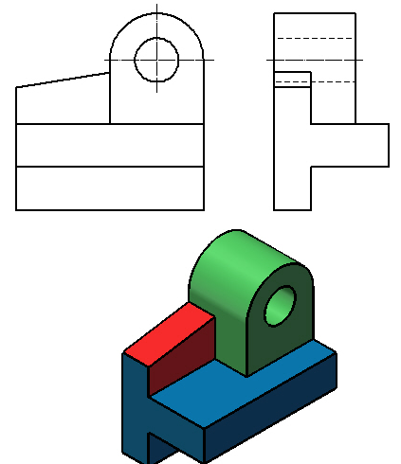
如果想用两个视图更准确表达此形体，主视图和左视图组合是更好的选择。
If you are required to represent this part by only two views, the combination of front and side views are better choice.

Slide 35
作业：P21，P22
Assignment： P21-22
Refer to textbook: P55-67

Slide 36
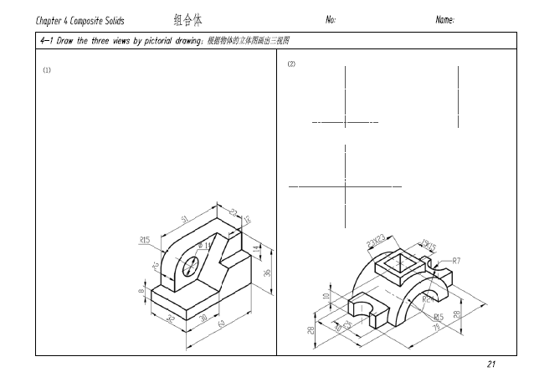
P21 scale 1:1

Slide 37

P22

Slide 38

课堂练习 画立体的三视图（用虚线表示不可见的线） 可以用尺子测量或者目测估计大小，不要求 绘图精度。可以用工具画也可以徒手画。 Class practice Draw the three views of the solid (hidden lines by dash linetypes) You can decide the size by approximation, no accuracy required)
前面 （主视图方向）

